Slide 1
How to cad
Ali short

Slide 2
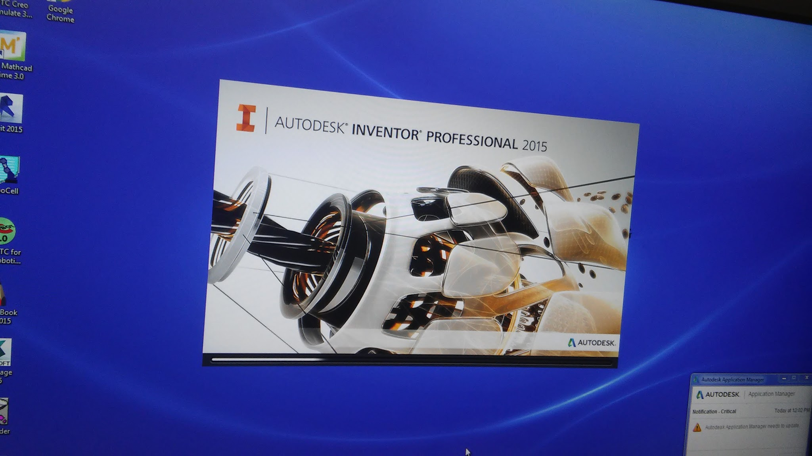
Open autodesk inventor

Slide 3
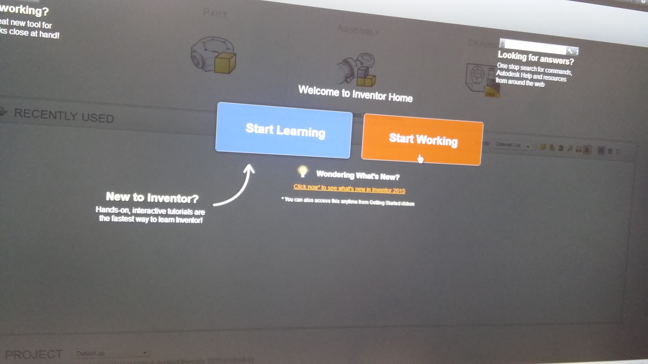
Click start working

Slide 4
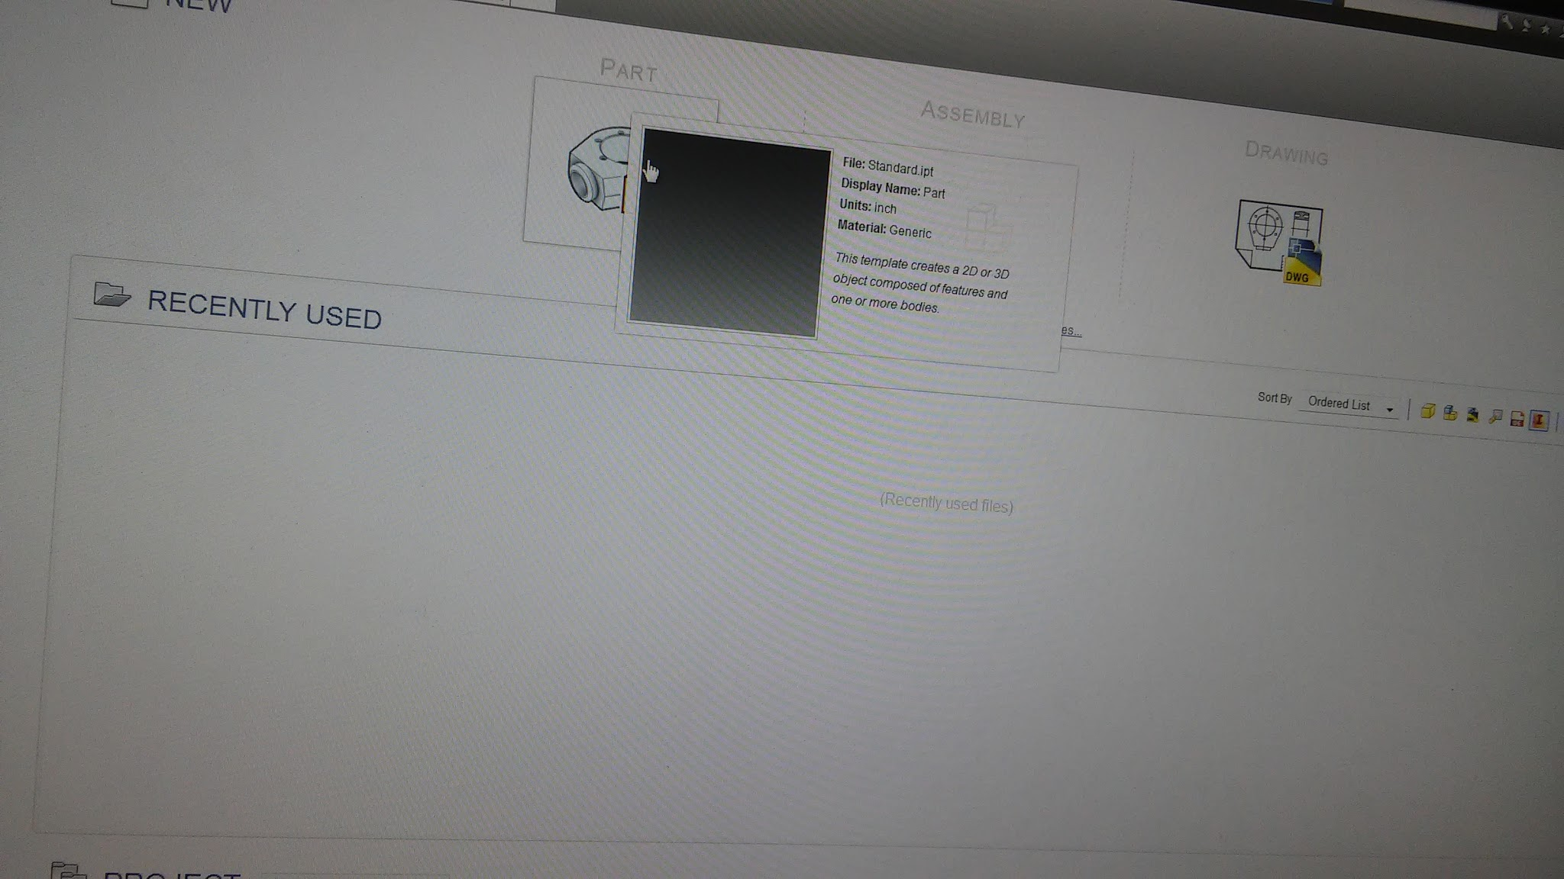
Select part

Slide 5
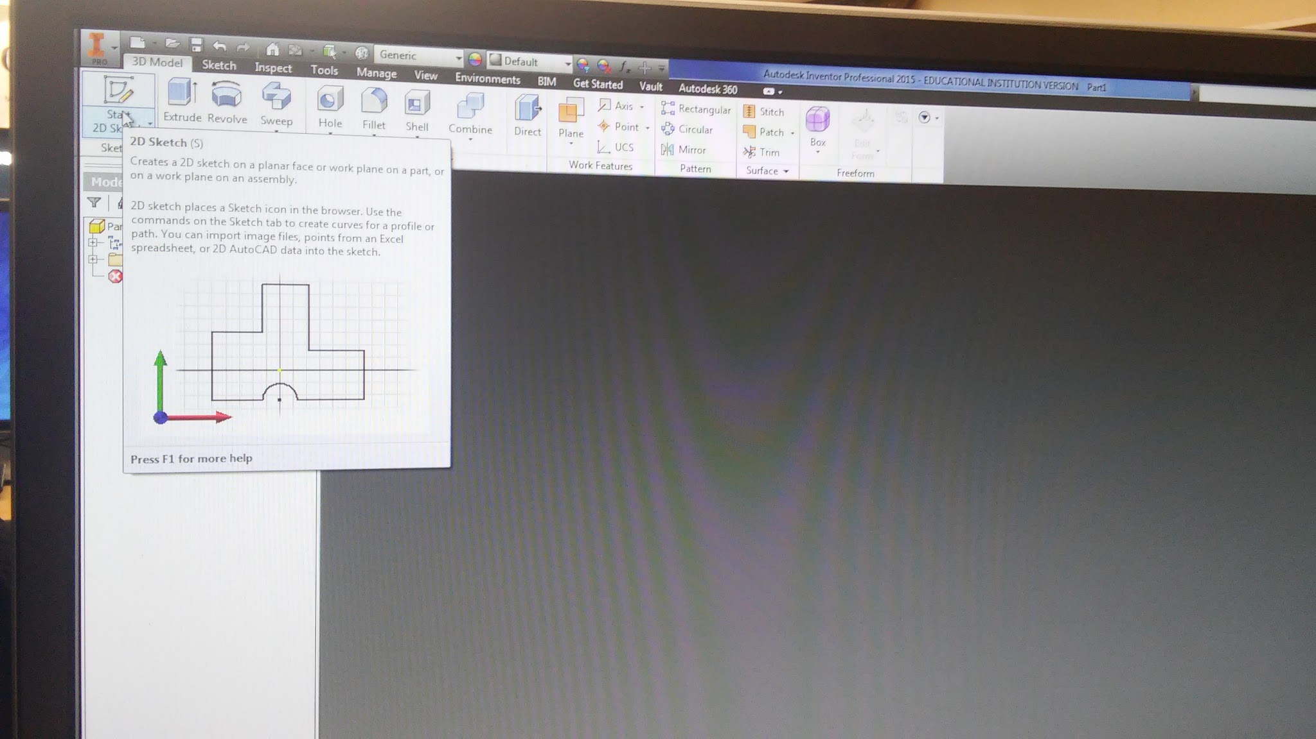
Select 2d sketch

Slide 6
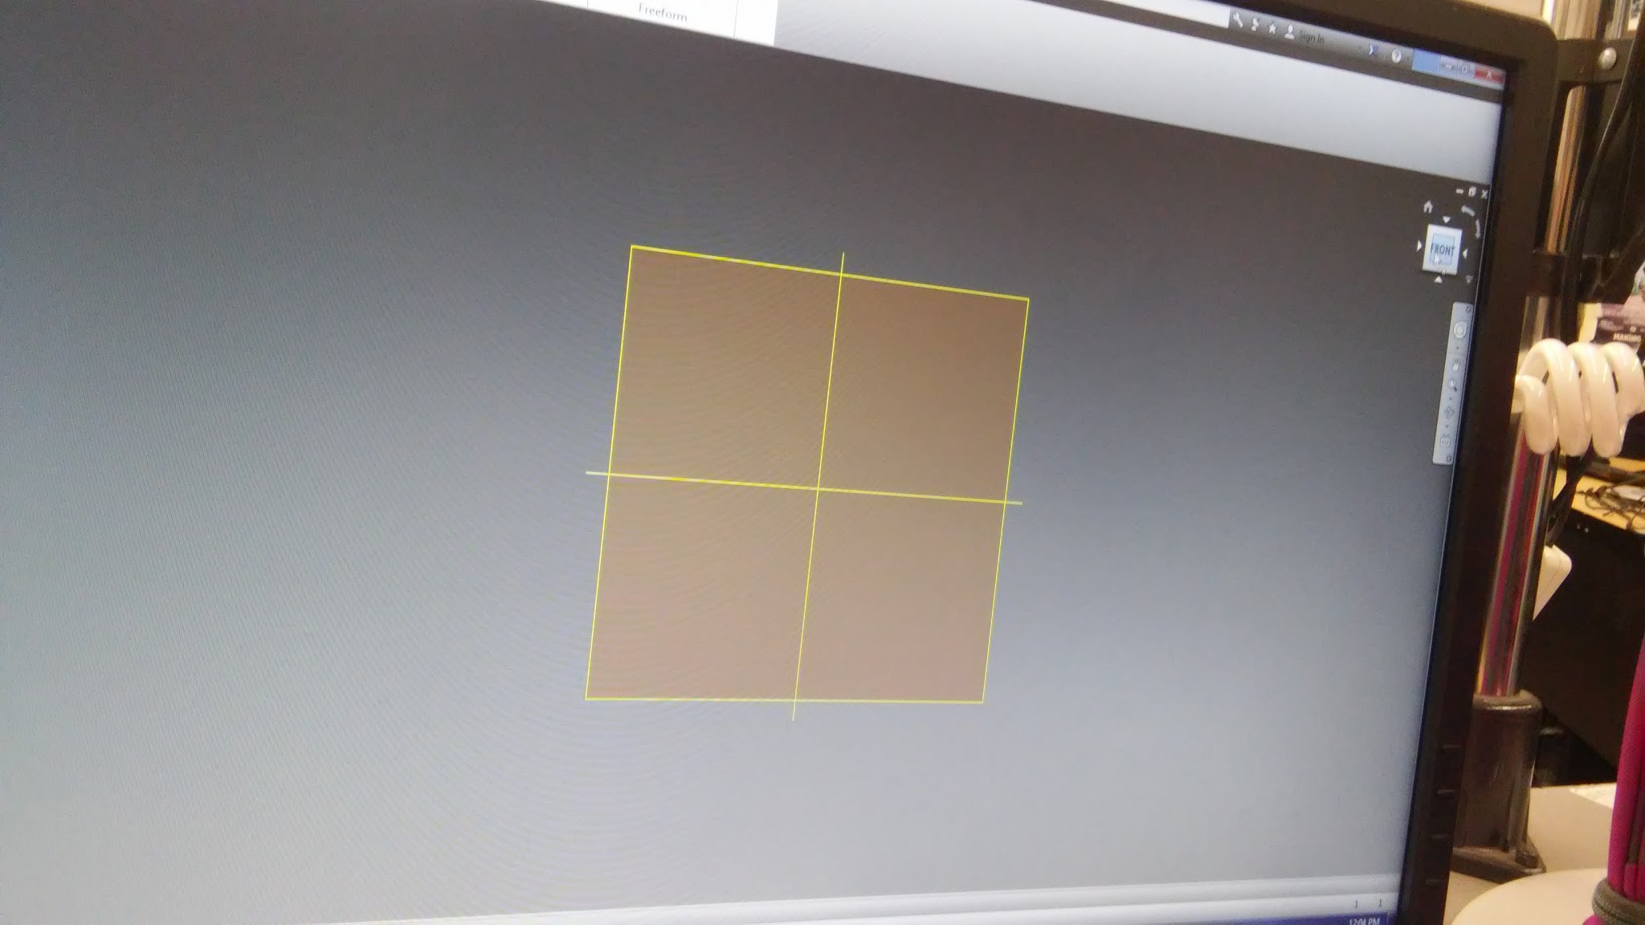
Select front click the plane to begin

Slide 7
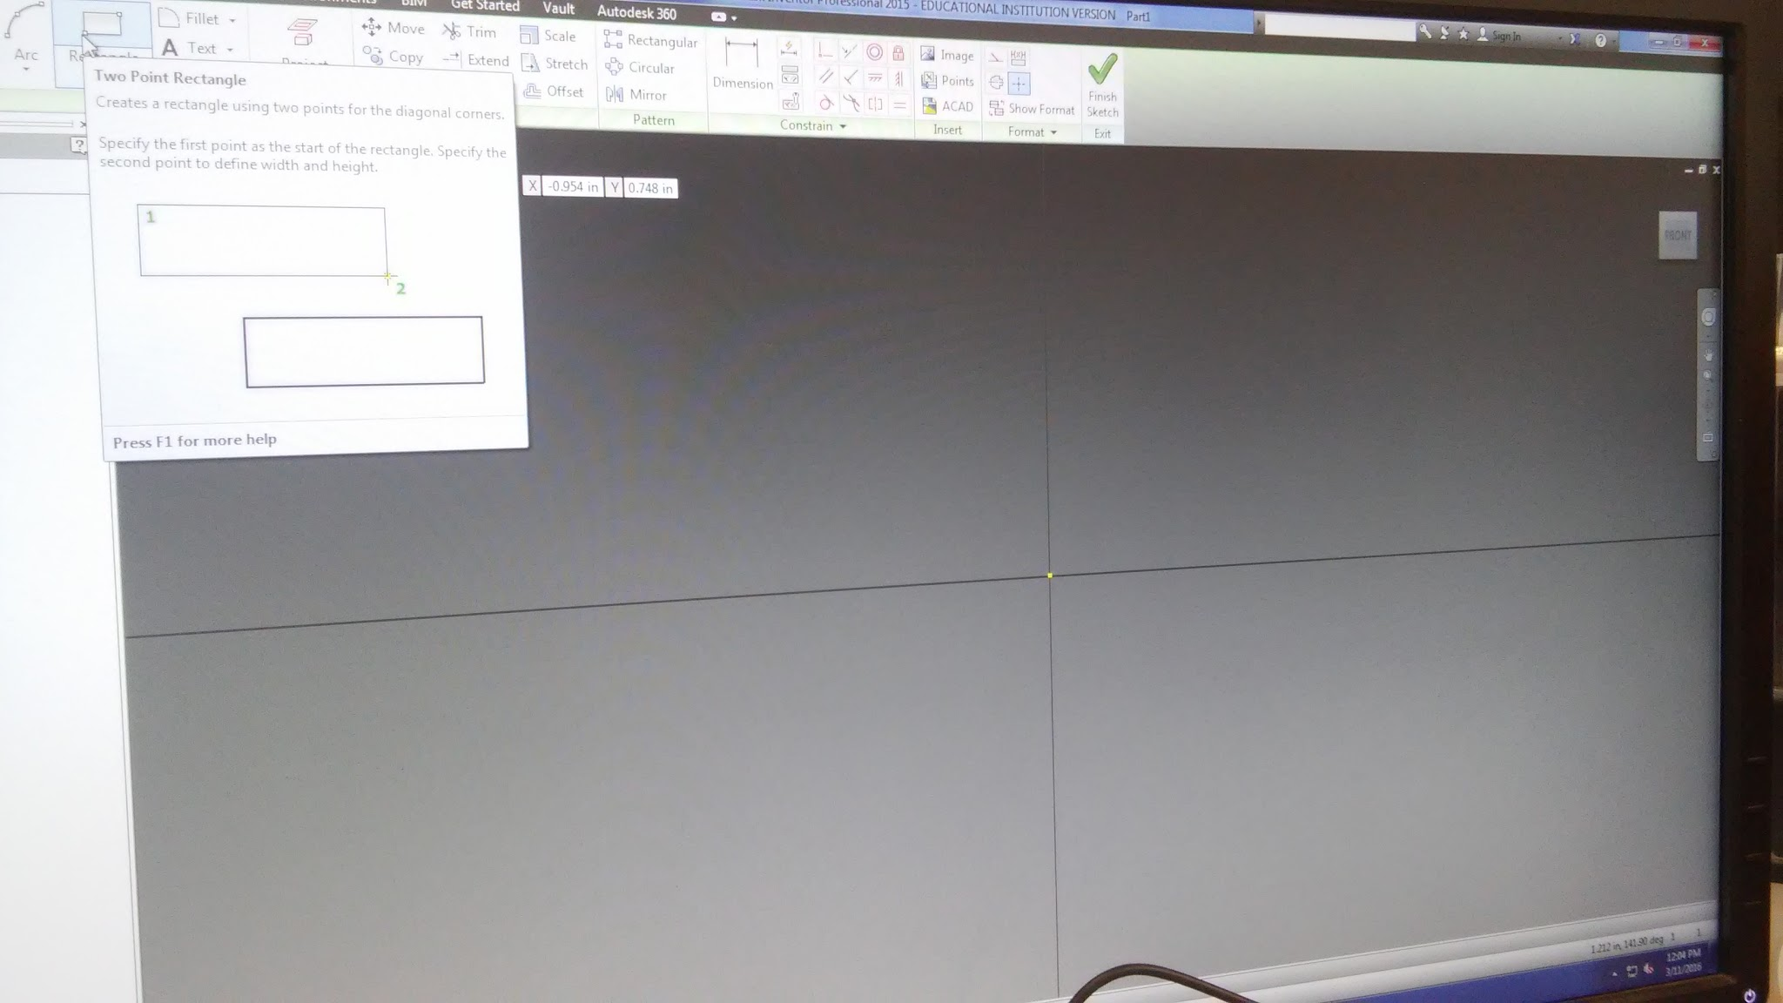
Select a rectangle click and drag on a point

Slide 8
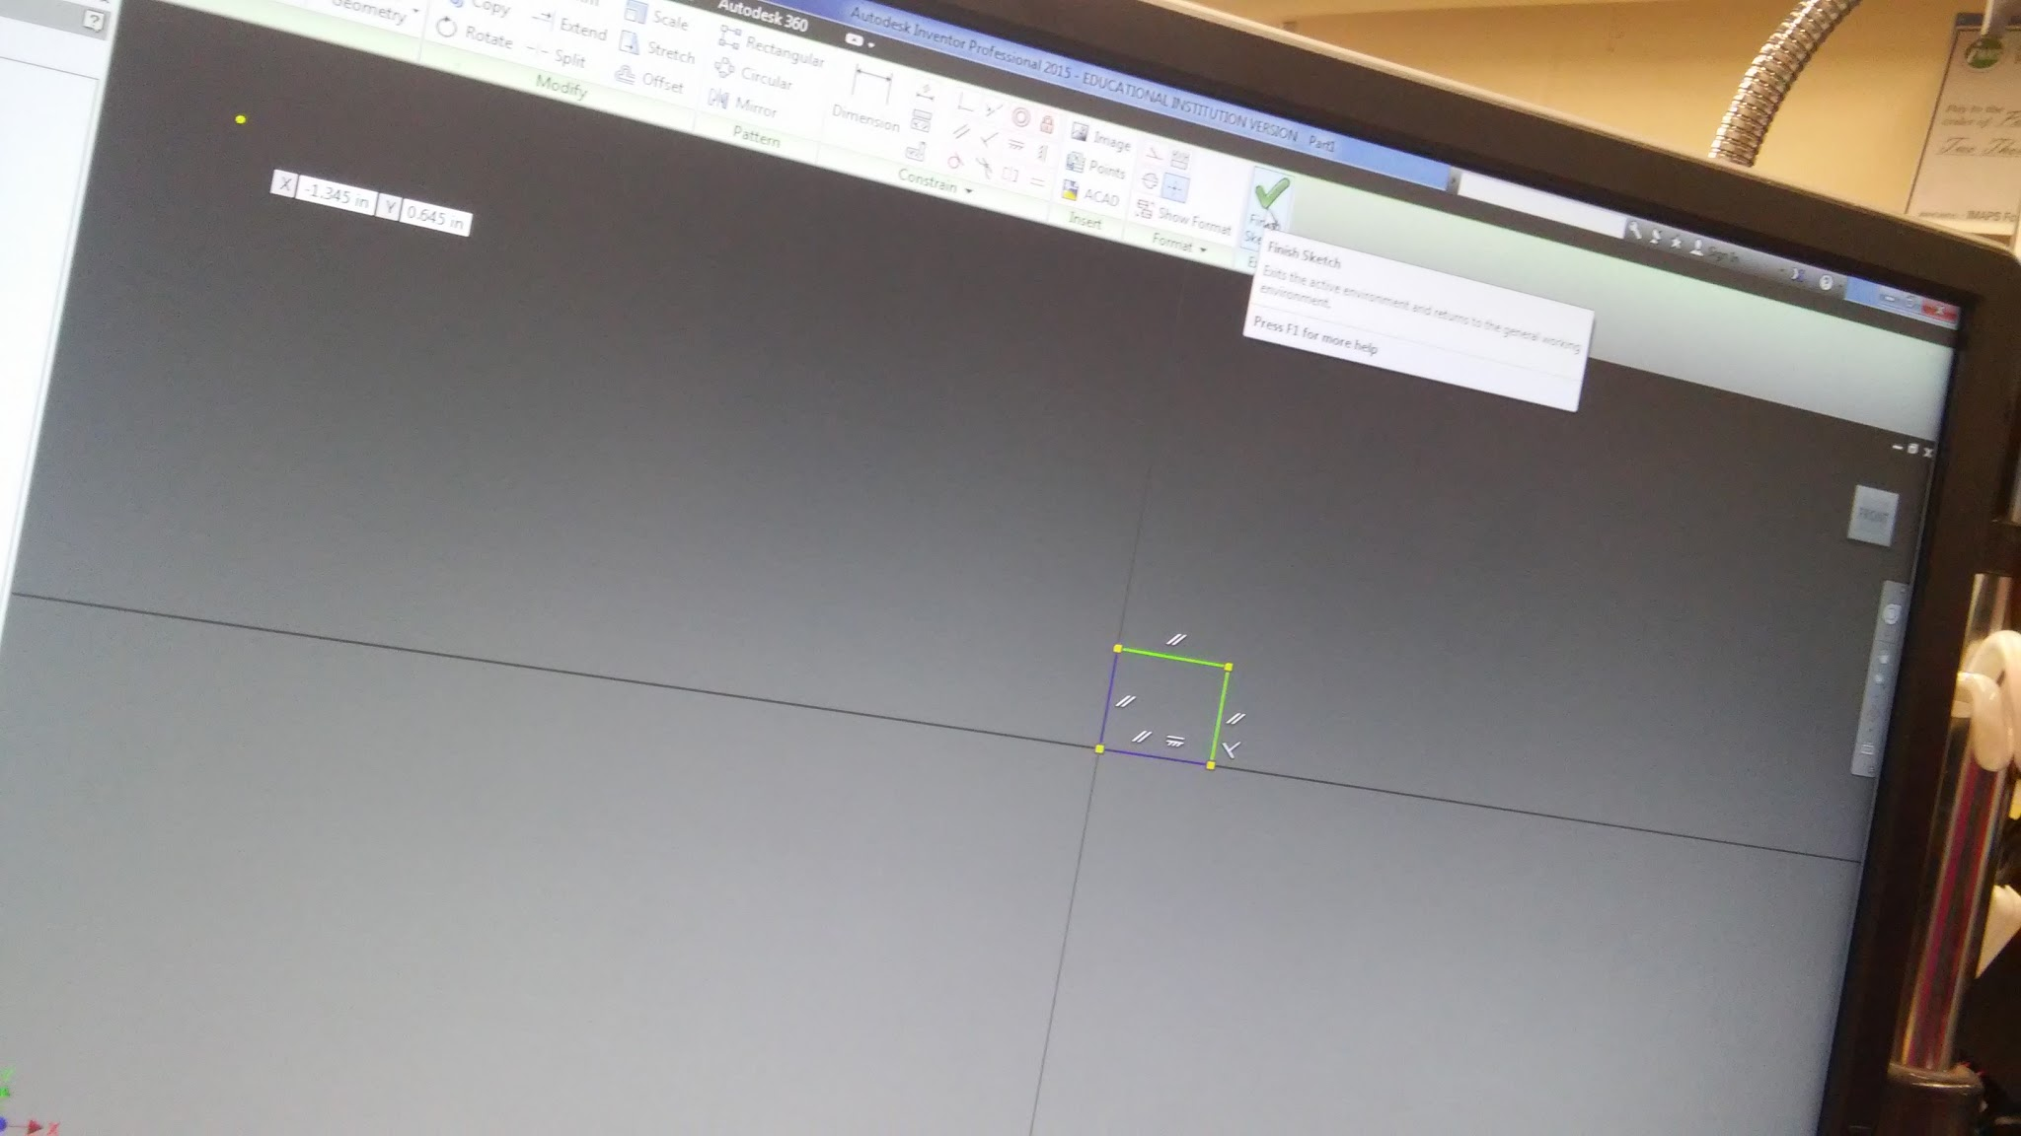
Click finish sketch

Slide 9
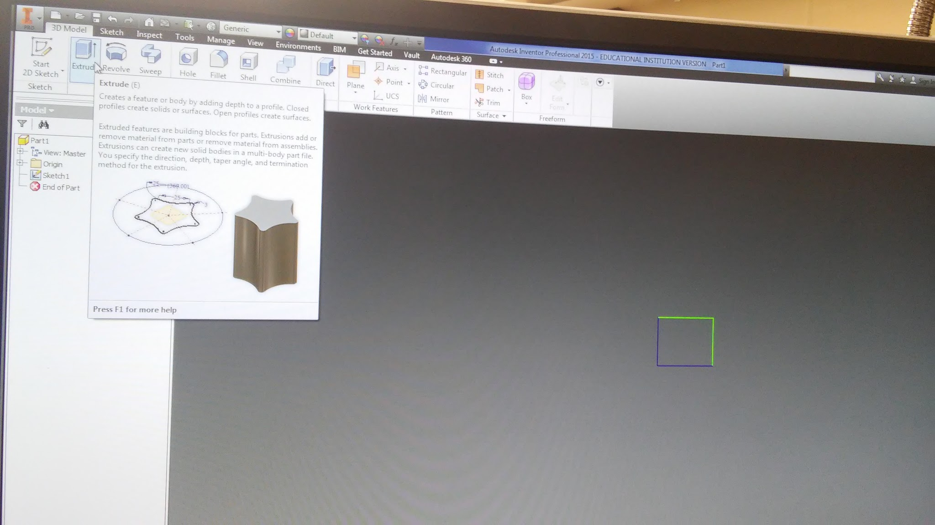
Select extrude

Slide 10
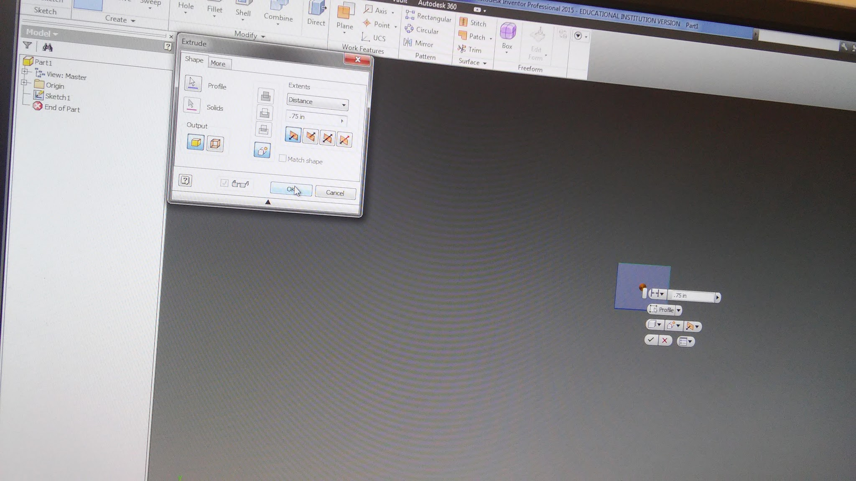
Set measurements and direction click ok

Slide 11
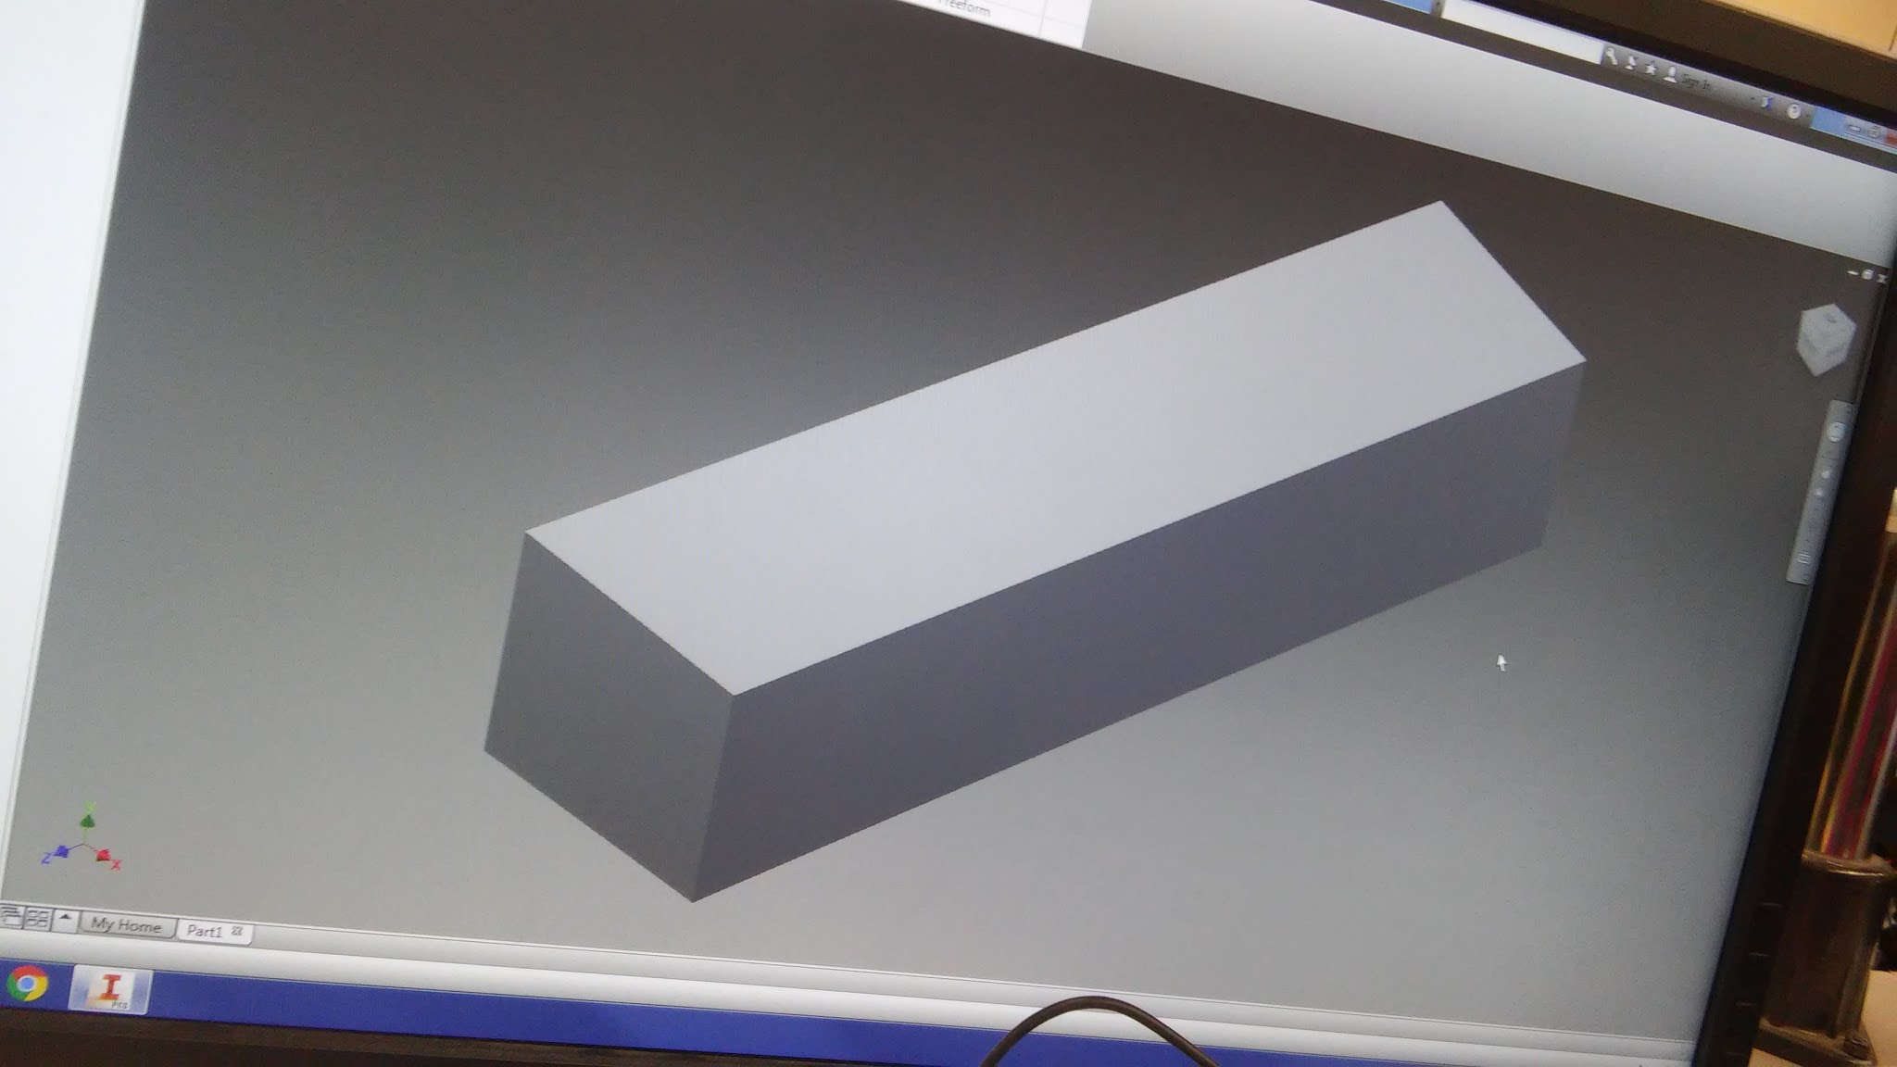
Look at it and smile

Slide 12
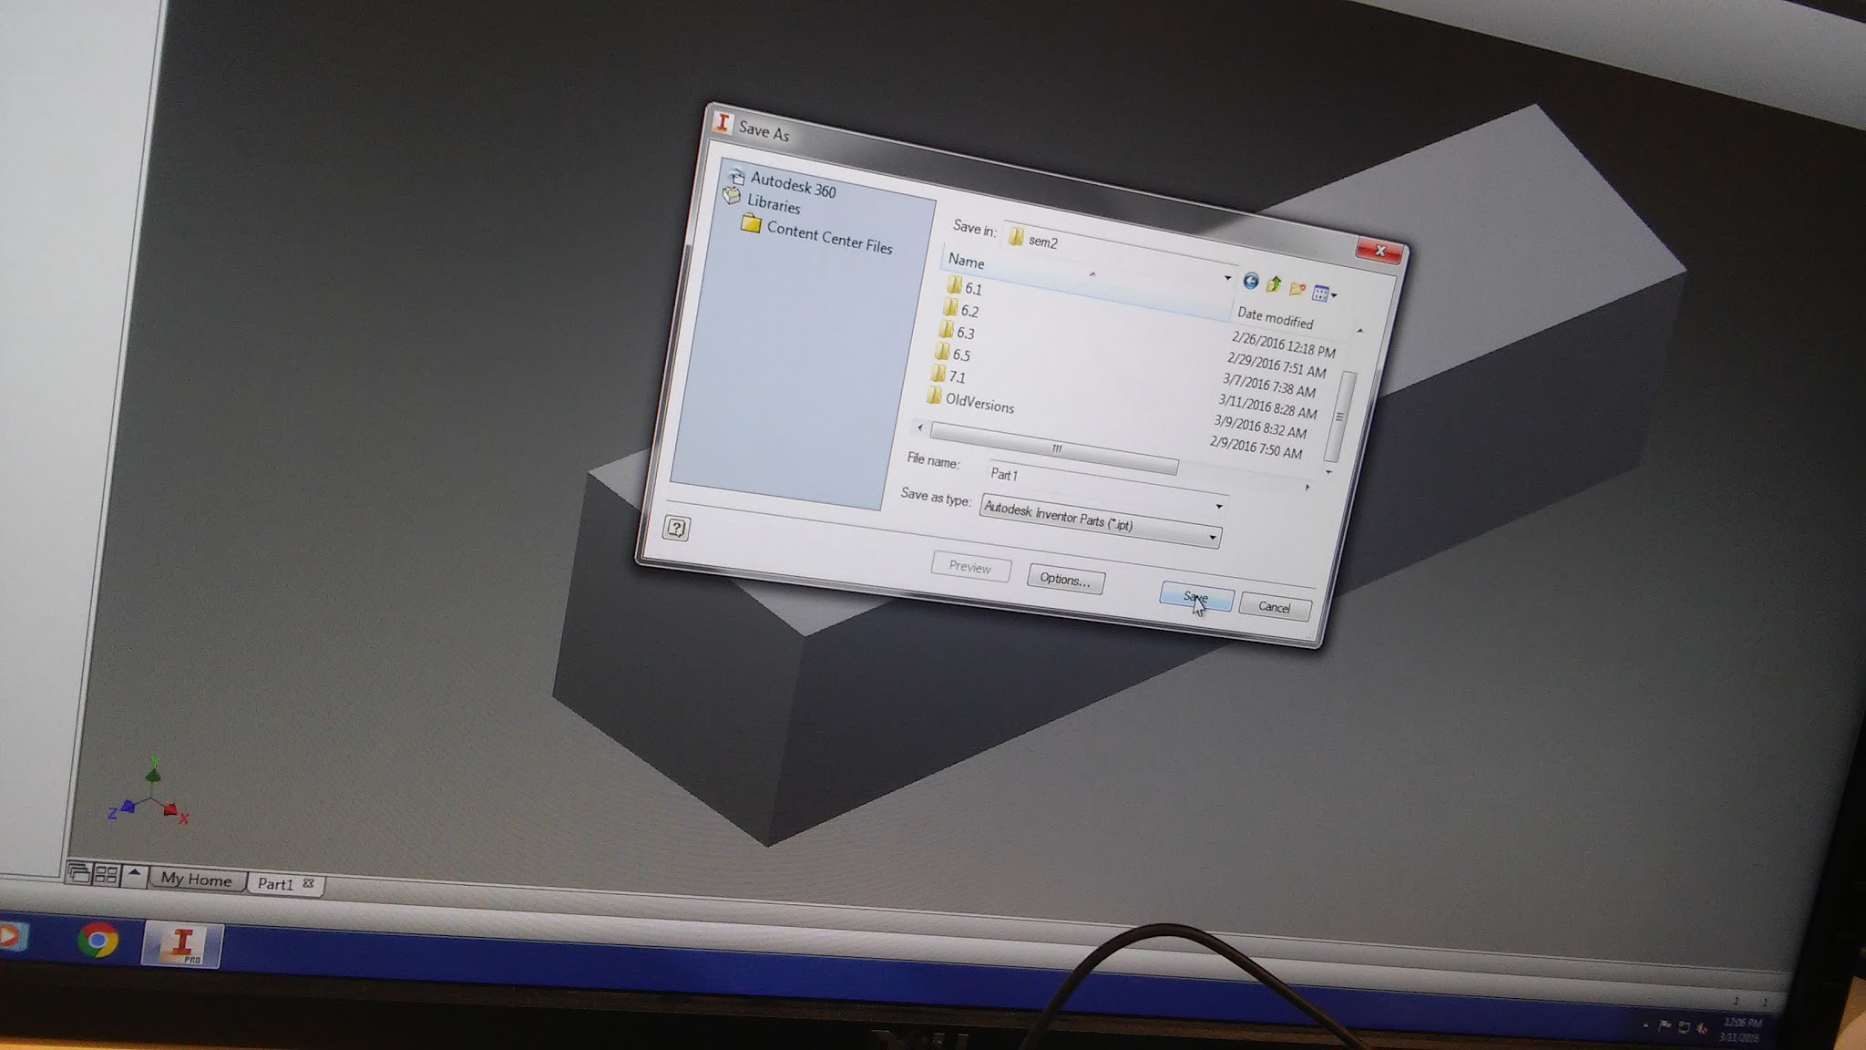
Save your work and done

